Slide 1
Randomized Algorithms CS648A
Lecture 4
Re-inventing algorithm for primality
Continuing Randomized Quick Sort
Random Variable and Expected value

Slide 2
Randomized algorithm for primality
Over the next few lectures, we shall try to re-invent the randomized polynomial time algorithm for determining if a number is prime.
We shall use basic modular arithmetic only instead of group theory.
In today’s lecture, we shall state Fermat’s little theorem.
Make sincere attempt to prove it.
Make sincere attempt to use it to design the algorithm for primality.

Slide 3
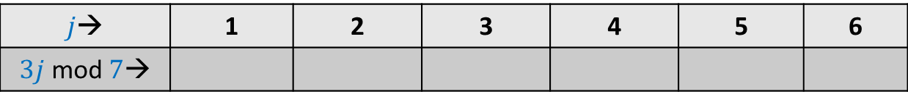

mod operation
$p$ : a prime number
$A$: {$1,2,…,p−1$}
Consider any $i∈A$.
Question: What can we say about set $A_{i}$ = { $ij mod p | j∈A$} ?
Example: $p=7$
$j$→ | 1 | 2 | 3 | 4 | 5 | 6
$3j$ mod $7$→
3
6
2
5
1
4

Slide 4
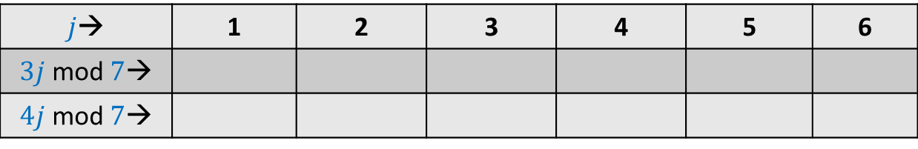
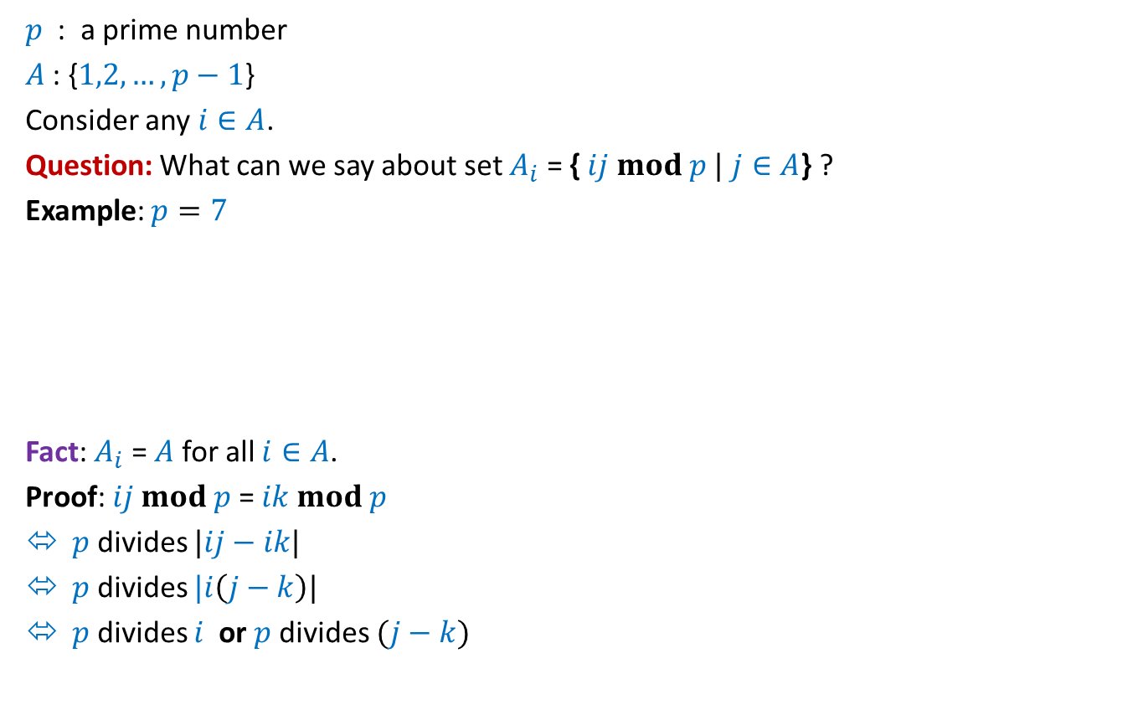
mod operation
$p$ : a prime number
$A$: {$1,2,…,p−1$}
Consider any $i∈A$.
Question: What can we say about set $A_{i}$ = { $ij mod p |$ $j∈A$} ?
Example: $p=7$
Fact: $A_{i}$ = $A$ for all $i∈A$.
Proof: $ij mod p$= $ik mod p$
$p$ divides $|ij−ik|$
$p$ divides $|i\left(j−k\right)|$
$p$ divides $i$ or $p$divides $(j−k)$
$j$→ | 1 | 2 | 3 | 4 | 5 | 6
$3j$ mod $7$→
$4j$ mod $7$→
3
6
2
5
1
4
4 1 5 2 6 3
Not possible

Slide 5
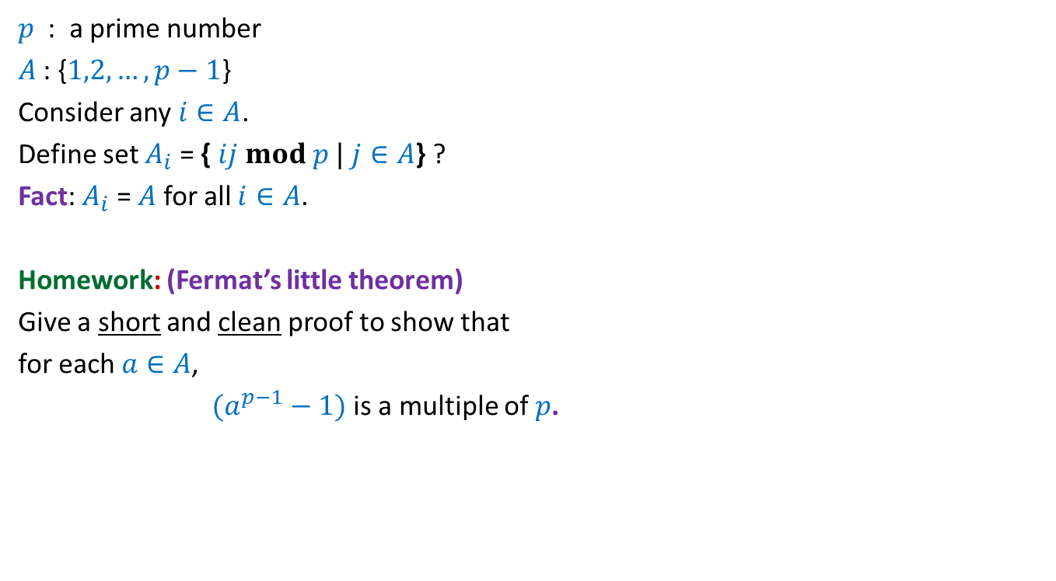
mod operation
$p$ : a prime number
$A$: {$1,2,…,p−1$}
Consider any $i∈A$.
Define set $A_{i}$ = { $ij mod p |$ $j∈A$} ?
Fact: $A_{i}$ = $A$ for all $i∈A$.
Homework: (Fermat’s little theorem)
Give a short and clean proof to show that
for each $a∈A$,
$(a^{p−1}−1)$is a multiple of $p$.

Slide 6
Balls Out of BIN

Slide 7


Balls Out of Bin
There is a bin containing $r$ red balls and $b$ blue balls.
Balls are taken out from the bag
Question: What is the probability that appears ahead of all blue balls. ?
uniformly randomly
and without replacement.
What if $r$ = 1 ?

Slide 8
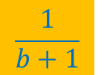
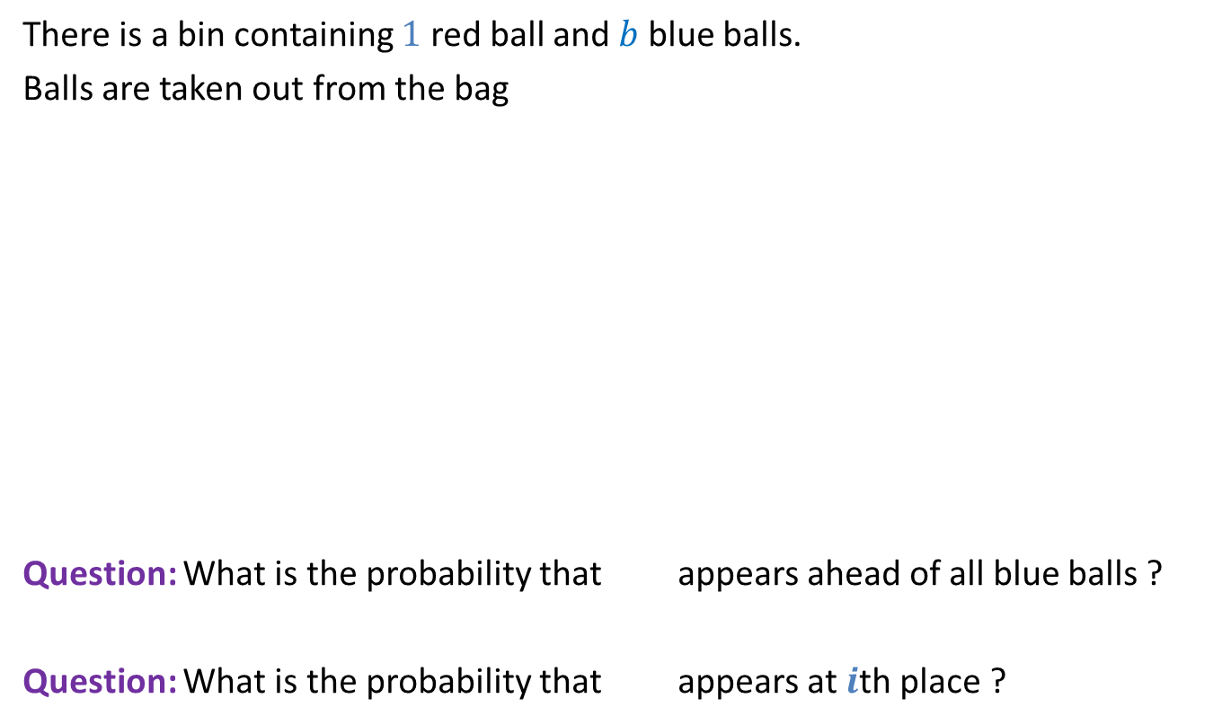
Balls Out of Bin
There is a bin containing $1$ red ball and $b$ blue balls.
Balls are taken out from the bag
Question: What is the probability that appears ahead of all blue balls ?
Question: What is the probability that appears at $i$th place ?
uniformly randomly
and without replacement.
$$\frac{1}{b+1}$$
$$\frac{1}{b+1}$$

Slide 9
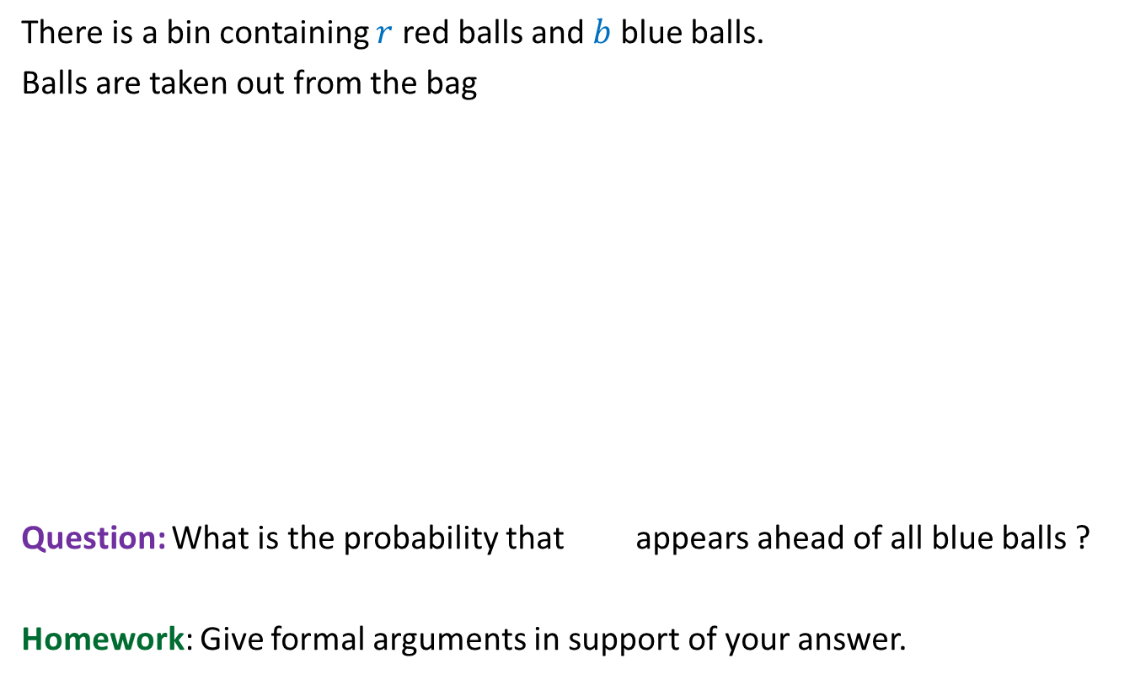
Balls Out of Bin
There is a bin containing $r$ red balls and $b$ blue balls.
Balls are taken out from the bag
Question: What is the probability that appears ahead of all blue balls ?
Homework: Give formal arguments in support of your answer.
uniformly randomly
and without replacement.
$$\frac{1}{b+1}$$

Slide 10
Randomized Quick sort

Slide 11
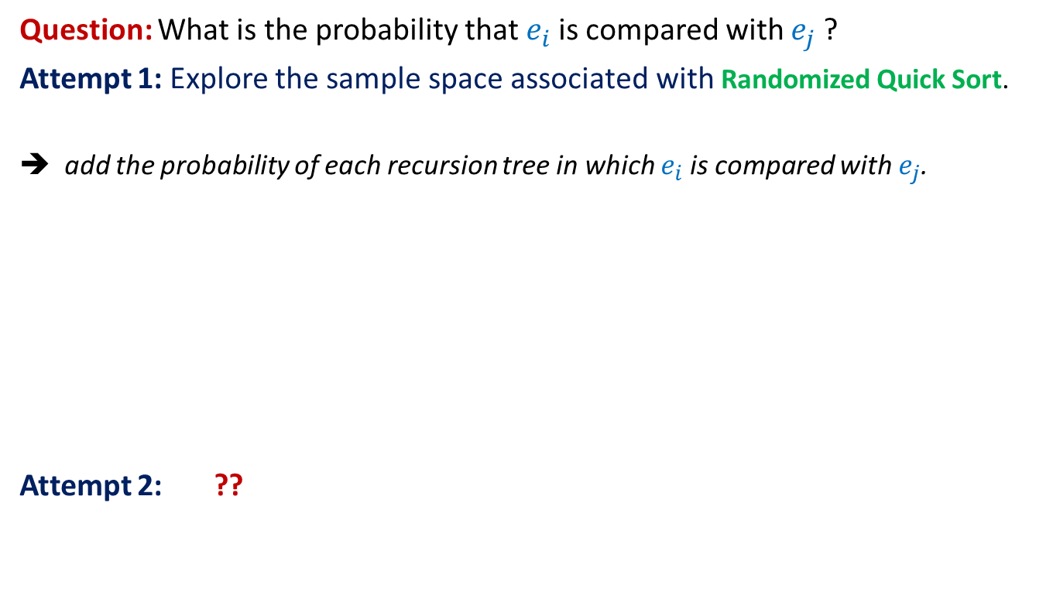
Randomized Quick Sort
Question: What is the probability that $e_{i}$is compared with $e_{j}$?
Attempt 1: Explore the sample space associated with Randomized Quick Sort.
➔ add the probability of each recursion tree in which $e_{i}$is compared with $e_{j}$.
Attempt 2: ??
Not a feasible way to calculate the probability
View the execution of RandomizedQuickSort from perspective of $e_{i}$ and $e_{j}$

Slide 12
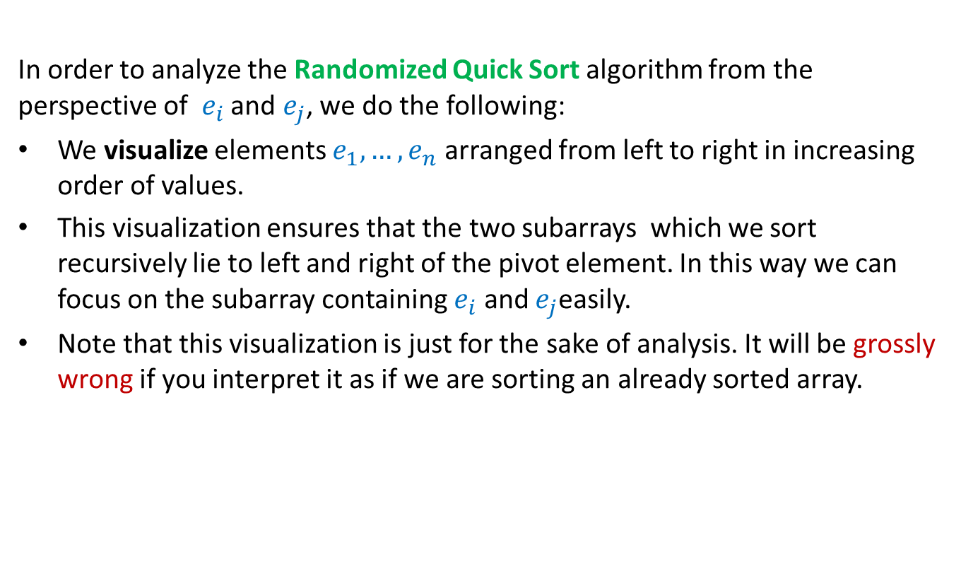

Randomized Quick Sort from perspective of $e_{i}$and $e_{j}$
In order to analyze the Randomized Quick Sort algorithm from the perspective of $e_{i}$ and $e_{j}$, we do the following:
We visualize elements $e_{1}, …, e_{n}$ arranged from left to right in increasing order of values.
This visualization ensures that the two subarrays which we sort recursively lie to left and right of the pivot element. In this way we can focus on the subarray containing $e_{i}$ and $e_{j}$easily.
Note that this visualization is just for the sake of analysis. It will be grossly wrong if you interpret it as if we are sorting an already sorted array.
Go through the next few slides slowly and patiently, pondering at each step. Never accept anything until and unless you can see the underlying truth yourself.

Slide 13



Randomized Quick Sort
from perspective of $e_{i}$and $e_{j}$
Recursion Tree
$$e_{i}$$
$$e_{j}$$
Elements of A arranged in Increasing order of values
Notes:
Let us look at the journey of ei and ej during an instance of randomized quick sort.
For this purpose, let us visualize all the elements of A arranged in the increasing order of values.
Let us see how the recursion tree unfolds itself.
In the first recursive call, obviously ei and ej are together.

Slide 14
Randomized Quick Sort
from perspective of $e_{i}$and $e_{j}$
Recursion Tree
$$e_{i}$$
$$e_{j}$$
pivot
. . .
. . .

Slide 15

Randomized Quick Sort
from perspective of $e_{i}$and $e_{j}$
Recursion Tree
$$e_{i}$$
$$e_{j}$$
pivot

Slide 16
Randomized Quick Sort
from perspective of $e_{i}$and $e_{j}$
Recursion Tree
$$e_{i}$$
$$e_{j}$$
pivot

Slide 17
Randomized Quick Sort
from perspective of $e_{i}$and $e_{j}$
Recursion Tree
$$e_{i}$$
$$e_{j}$$
pivot

Slide 18
Randomized Quick Sort
from perspective of $e_{i}$and $e_{j}$
Recursion Tree
$$e_{i}$$
$$e_{j}$$
pivot
Not Compared

Slide 19
Randomized Quick Sort
from perspective of $e_{i}$and $e_{j}$
Recursion Tree
$$e_{i}$$
$$e_{j}$$
pivot
Compared

Slide 20
Randomized Quick Sort
from perspective of $e_{i}$and $e_{j}$
Recursion Tree
$$e_{i}$$
$$e_{j}$$
pivot
Compared

Slide 21







Randomized Quick Sort
from perspective of $e_{i}$and $e_{j}$
$$e_{i}$$
$$e_{j}$$
Observation 1:
$e_{i}$and $e_{j}$get compared during an instance of Randomized Quick Sort iff
the first pivot element selected from $S_{ij}$is either $e_{i}$or $e_{j}$.
$$S_{ij}$$
$e_{i}$and $e_{j}$ be compared
No influence
$e_{i}$and $e_{j}$ be compared
$e_{i}$and $e_{j}$ will not be compared
No influence
Take a closer look on the sequence of pivot elements to find their influence on “the possibility” of comparison between $e_{i}$and $e_{j}$ .
To determine the probability of this event, let us have a look at Randomized Quick Sort from perspective of $S_{ij}$.

Slide 22


Randomized Quick Sort
from perspective of $S_{ij}$
$$e_{i}$$
$$e_{j}$$
Each element is equally likely to be the pivot element in this recursive call.
Observation 2: During Randomized Quick Sort, each element from the set $S_{ij}$
is equally likely to be picked as the first pivot element among $S_{ij}$.
Each element is equally likely to be the pivot element in this recursive call.
Each element is equally likely to be the pivot element in this recursive call.
Each element is equally likely to be the pivot element in this recursive call.
Each element is equally likely to be the pivot element in this recursive call.
Notes:
Let k = |S_ij| = j-i+1,
Claim: Probability that e_i is the first pivot element from S_ij = 1/k
Induction on n - the size of the array.
Base case: n=S_ij
Induction hypothesis: P[B(m)] = 1/k for all m<n.
Induction step:
A : first pivot element of the array is from S_ij
P[B] = P[B| A] P[A] + P[B | \bar{A}] (1-P[A])
= 1/k . k/n + 1/k . (1-k/n)
= 1/k.

Slide 23






Randomized Quick Sort from perspective of $e_{i}$and $e_{j}$
Let us define two events.
$B_{i}$ : first pivot element selected from $S_{ij}$ during Randomized Quick Sort is $e_{i}$.
$B_{j}$ : first pivot element selected from $S_{ij}$ during Randomized Quick Sort is $e_{j}$.
Pr[$e_{i}$and $e_{j}$get compared] = ??
= Pr[$B_{i}$] + Pr[$B_{j}$] - Pr[$B_{i}$ ∩$B_{j}$]
= Pr[$B_{i}$] + Pr[$B_{j}$]
= $\frac{1}{j−i+1}$+ $\frac{1}{j−i+1}$
= $\frac{2}{j−i+1}$
Pr[$B_{i}$U$B_{j}$]
What relation exists between $B_{i}$ and $B_{j}$ ?
Pr[$B_{i}$] = $\frac{1}{|S_{ij}|}$ using Observation 2
What is Pr[$B_{i}$] ?
$B_{i}$ and $B_{j}$are disjoint events.

Slide 24
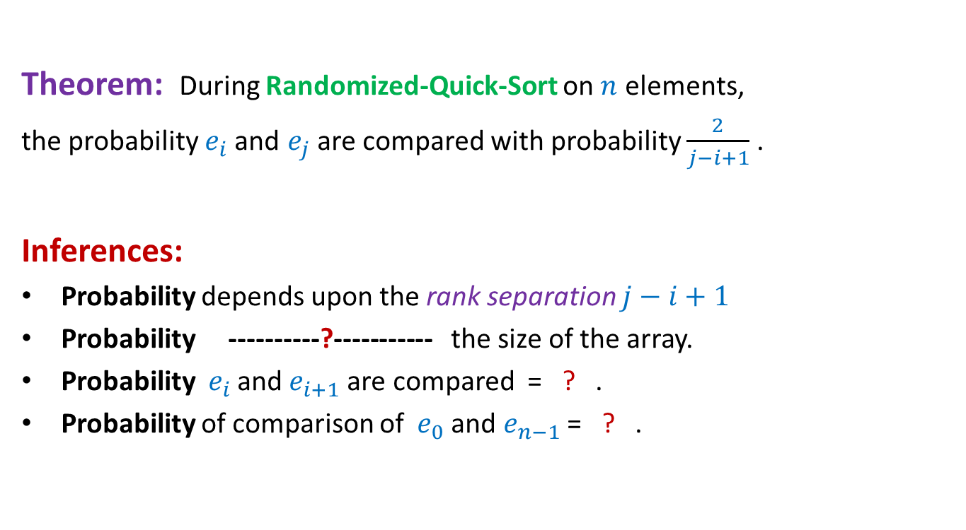


Randomized Quick Sort from perspective of $e_{i}$and $e_{j}$
Theorem: During Randomized-Quick-Sort on $n$ elements,
the probability $e_{i}$and $e_{j}$ are compared with probability $\frac{2}{j−i+1}$ .
Inferences:
Probability depends upon the rank separation $j−i+1$
Probability ----------?----------- the size of the array.
Probability ${ e}_{i}$and $e_{i+1}$are compared = ? .
Probability of comparison of ${ e}_{0}$and $e_{n−1}$= ? .
is independent of
$$1$$
$$\frac{2}{n}$$

Slide 25
probability theory
Random variable
and
expected value

Slide 26

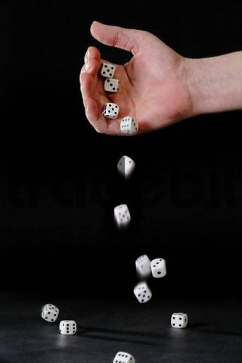
Random variable
Randomized-Quick-Sort
on array of size n
Number of HEADS in 5 tosses
Sum of numbers in 4 throws
Number of comparisons

Slide 27

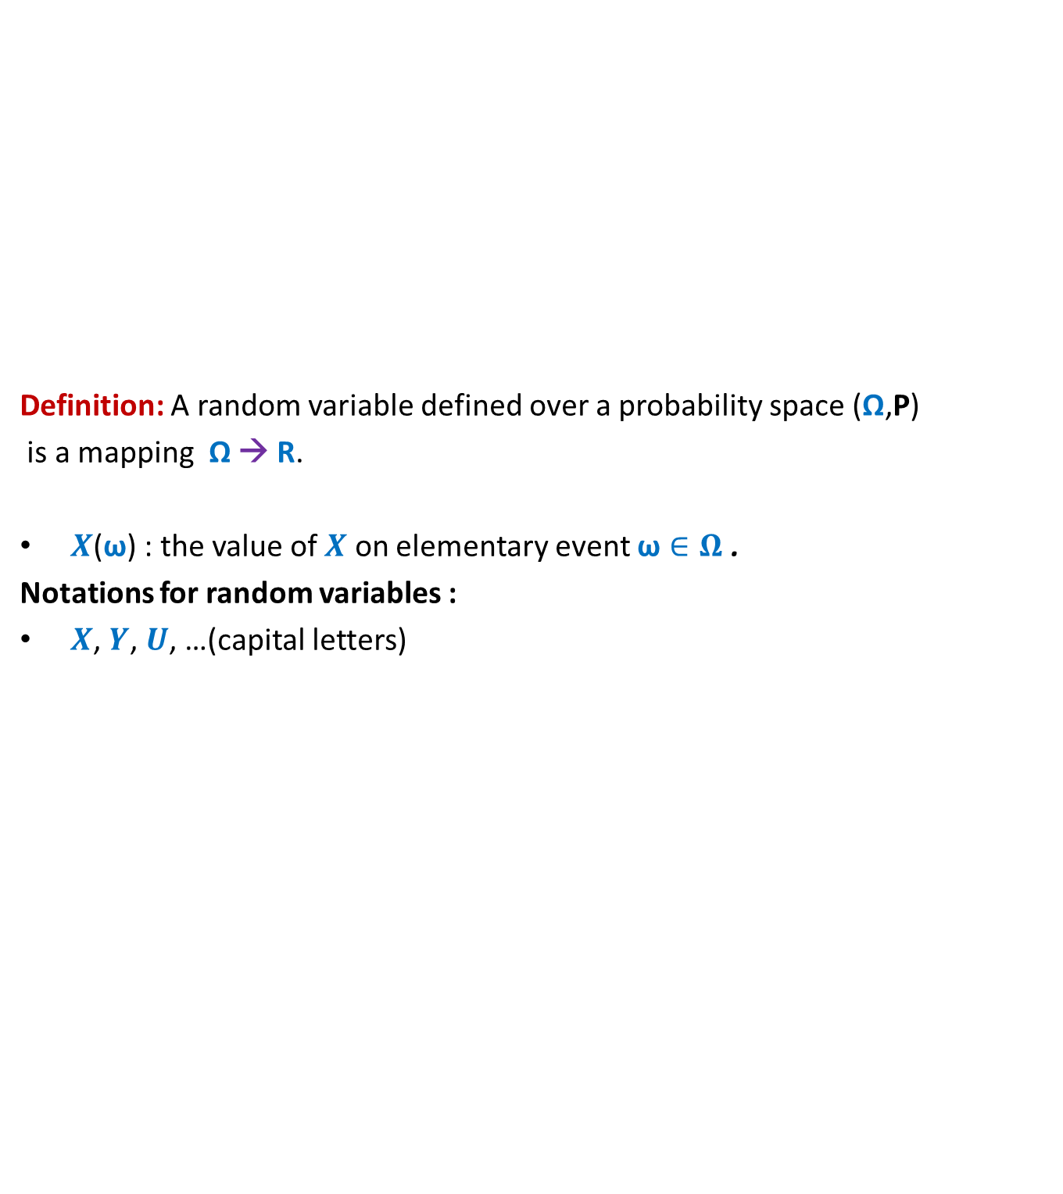
Random variable
Definition: A random variable defined over a probability space (Ω,P)
is a mapping Ω → R.
$X$($\text{ω}$) : the value of $X$ on elementary event $\text{ω}∈Ω$ .
Notations for random variables :
$X$, $Y$, $U$, …(capital letters)
$$X$$
Set of real numbers
R
Ω

Slide 28
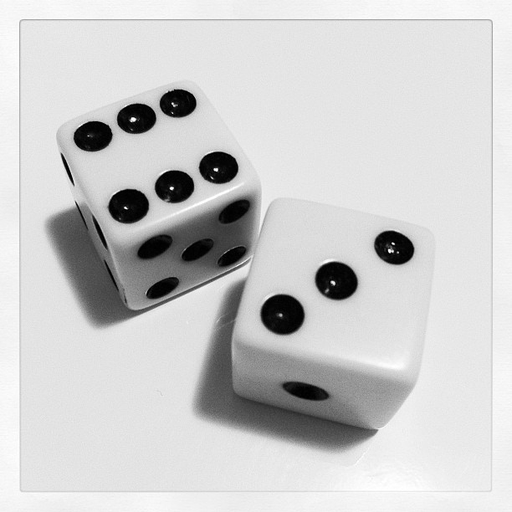
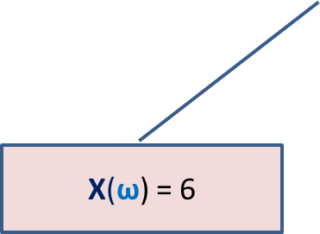
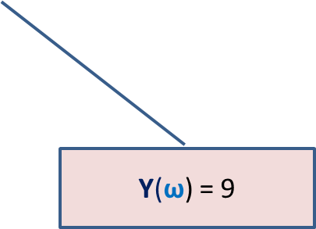

Many Random Variables for the same Probability space
Random Experiment: Throwing a dice two times
X : the largest number seen
Y : sum of the two numbers seen
X($\text{ω}$) = 6
$$\text{ω}$$
Y($\text{ω}$) = 9

Slide 29
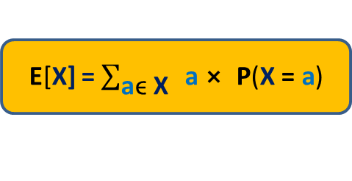

Expected Value of a random variable (average value)
Definition: Expected value of a random variable X defined over a probability space (Ω,P) is
E[X] = $\sum_{\text{ω}\text{ϵ} \text{Ω}}{\text{X}\text{(}\text{ω}\text{)}⨯ \text{P}\text{(}\text{ω}\text{)}}$
X= c
Ω
X= a
X= b
E[X] = $\sum_{\text{a}\text{ϵ} \text{X}}{ \text{a}⨯ \text{P}\text{(}\text{X}\text{ = }\text{a}\text{)}}$

Slide 30
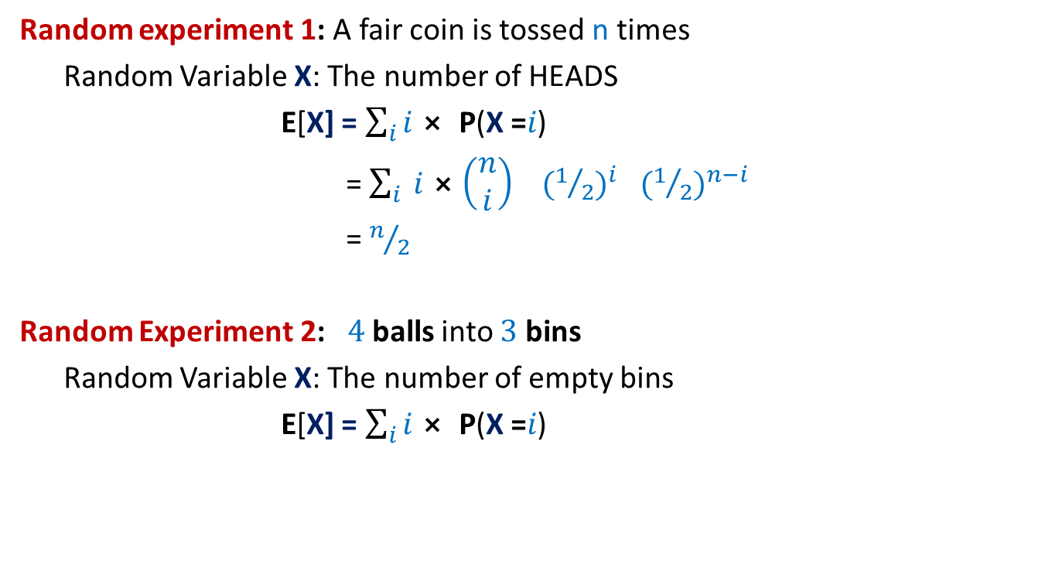
Examples
Random experiment 1: A fair coin is tossed n times
Random Variable X: The number of HEADS
E[X] = $\sum_{i}{i⨯ \text{P}\text{(}\text{X}\text{ =}i\text{)}}$
= $\sum_{i}{ i⨯\left(\begin{matrix}n \\ i\end{matrix}\right)}{ (1/2)}^{i}{ (1/2)}^{n−i}$
= $n/2$
Random Experiment 2: $4$balls into $3$ bins
Random Variable X: The number of empty bins
E[X] = $\sum_{i}{i⨯ \text{P}\text{(}\text{X}\text{ =}i\text{)}}$

Slide 31
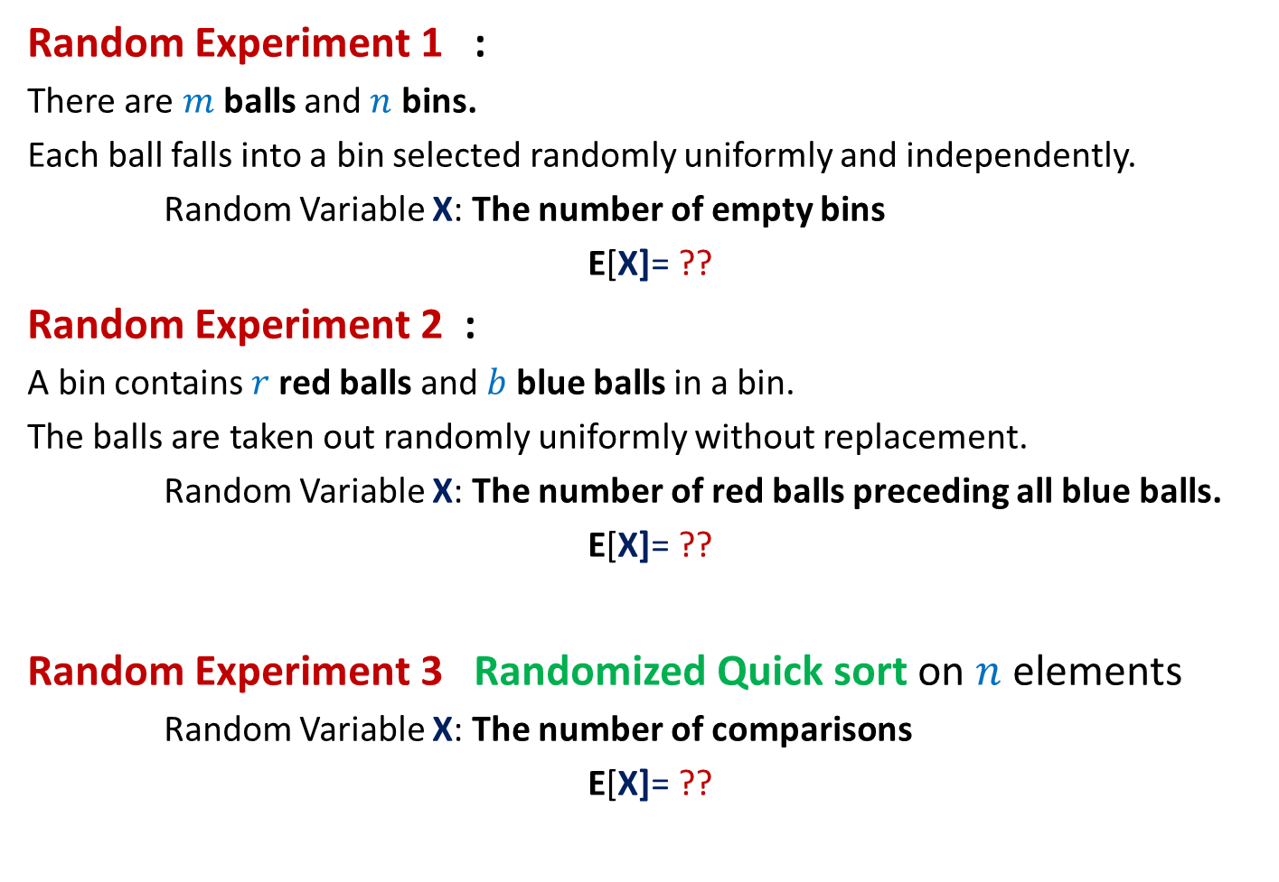
Can we solve these problems ?
Random Experiment 1 :
There are $m$balls and $n$ bins.
Each ball falls into a bin selected randomly uniformly and independently.
Random Variable X: The number of empty bins
E[X]= ??
Random Experiment 2 :
A bin contains $r$red balls and $b$ blue balls in a bin.
The balls are taken out randomly uniformly without replacement.
Random Variable X: The number of red balls preceding all blue balls.
E[X]= ??
Random Experiment 3 Randomized Quick sort on $n$ elements
Random Variable X: The number of comparisons
E[X]= ??

Slide 32
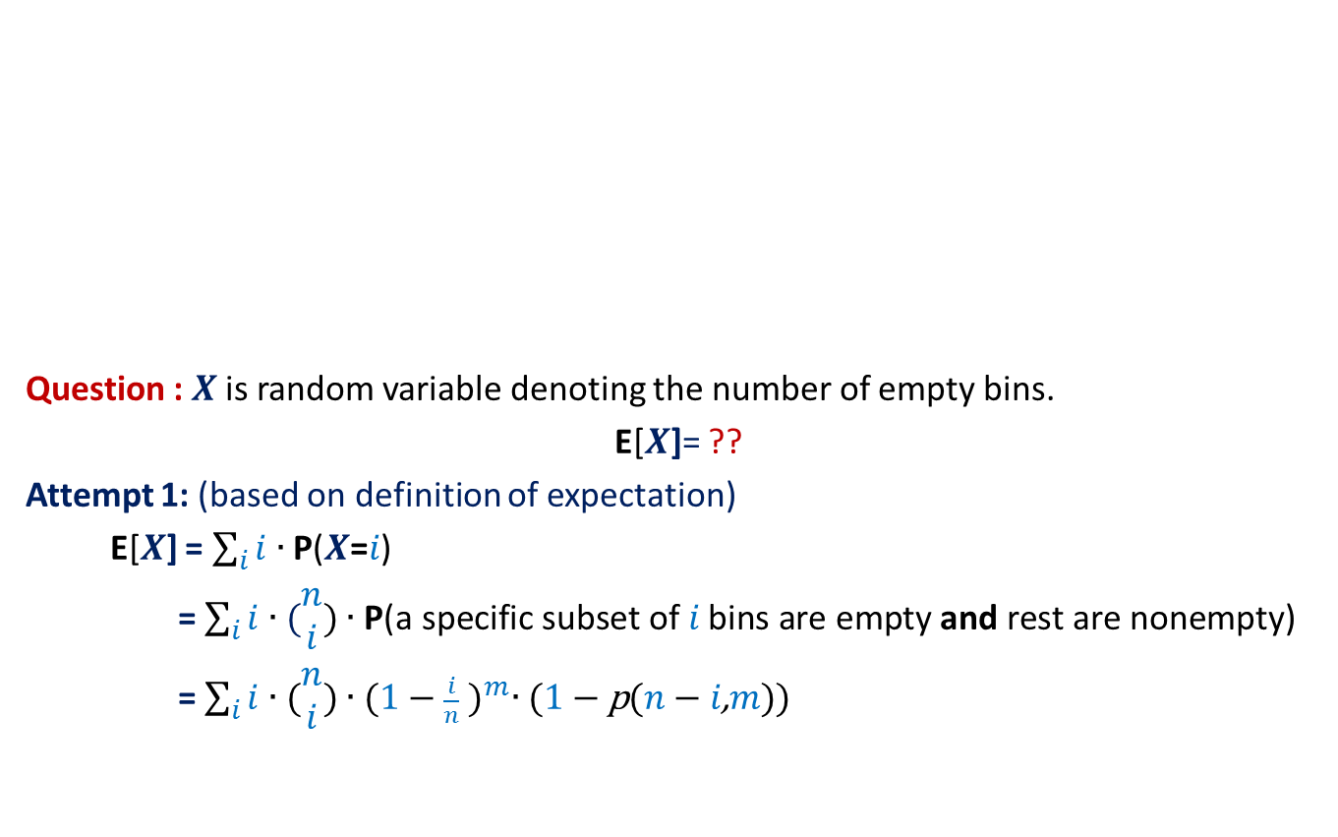


Balls into Bins (number of empty bins)
1 2 3 4 5 … $m−1$ $m$
Question : $X$ is random variable denoting the number of empty bins.
E[$X$]= ??
Attempt 1: (based on definition of expectation)
E[$X$] = $\sum_{i}{i∙\text{P}\text{(}X\text{=}i\text{)}}$
= $\sum_{i}{i∙(\begin{matrix}n \\ i\end{matrix}\text{)}∙\text{P}\text{(}\text{a} \text{specific} \text{subset} \text{of} i \text{bins} \text{are} \text{empty} \text{and} \text{rest} \text{are} \text{nonempty}\text{)}}$
= $\sum_{i}{i∙(\begin{matrix}n \\ i\end{matrix}\text{)}∙{(1−\frac{i}{n} )}^{m}∙\text{(}\text{1}−\text{p}\text{(}n−i\text{,}m\text{))}}$
A subset of $i$ bins
1 2 3 … … $n$
This is a right answer.
But it is useless !

Slide 33

Randomized Quick Sort (number of comparisons)
Question : Y is random variable denoting the number of comparisons.
E[Y]= ??
Attempt 1: (based on definition of expectation)
E[Y] = $\sum_{i}{i∙\text{P}\text{(}\text{Y}\text{ =}i\text{)}}$
A recursion tree
associated with Randomized Quick Sort
We can not proceed from this point …☹

Slide 34

Since viewing the random experiment in its entirety looks so complex, let us take a microscopic view.
Balls into Bins (number of empty bins)
1 2 3 4 5 … $m−1 m$
1 2 3 … … $n$
Randomized Quick Sort (number of comparisons)

Slide 35

Balls into Bins (number of empty bins)
$$1 2 3 4 5 … m−1 m$$
Question: Let $X_{i}$ be a random variable defined as follows.
$X_{i}$ = $\left\{\begin{matrix}1 if ith bin is empty \\ 0 otherwise \end{matrix}\right.$
What is E[$X_{i}$] ?
Answer : E[$X_{i}$] = $1$ $∙$ $\text{P}\text{(}ith bin is empty\text{) }$ + $0$ $∙$ $\text{P}\text{(}ith bin is not empty\text{) }$
= $\text{P}\text{(}ith bin is empty\text{)}$
= ${(1−\frac{1}{n} )}^{m}$
1 2 3 … $i$ … $n$

Slide 36




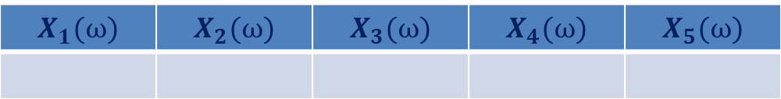
Balls into Bins (any relation between $X$ and $X_{i}$’s ?)
Consider any elementary event.
$X\left(ω\right)=2$
1 2 3 4 5 6
An elementary event
$$ω$$
number of empty bins
1 2 3 4 5
$$X_{1}(ω)$$ | $$X_{2}(ω)$$ | $$X_{3}(ω)$$ | $$X_{4}(ω)$$ | $$X_{5}(ω)$$
0
1
0
1
0
$X\left(ω\right)=$ $X_{1}\left(ω\right)+$ $X_{2}\left(ω\right)+$ $X_{3}\left(ω\right)+$ $X_{4}\left(ω\right)+$ $X_{5}\left(ω\right)$
for each $ω$ ϵ Ω

Slide 37

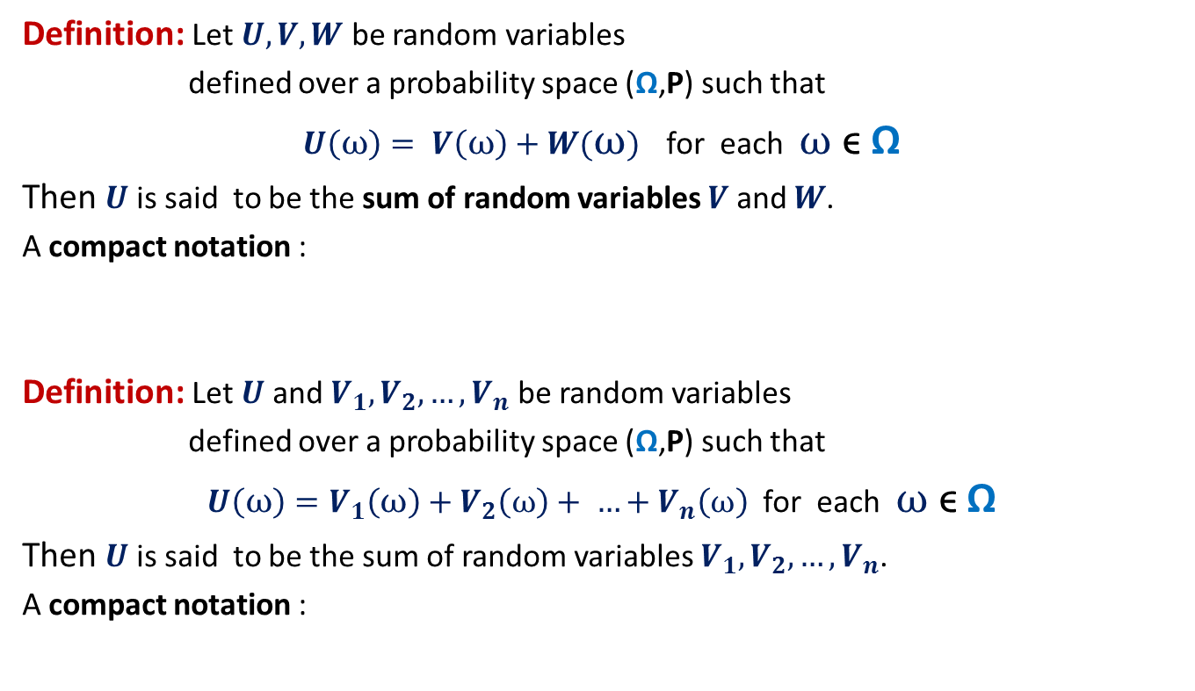

Sum of Random Variables
Definition: Let $U,V,W$ be random variables
defined over a probability space (Ω,P) such that
$U\left(ω\right)= V\left(ω\right)+W(ω)$ for each $ω$ ϵ Ω
Then $U$ is said to be the sum of random variables $V$ and $W$.
A compact notation :
Definition: Let $U$and $V_{1},V_{2},…,V_{n}$ be random variables
defined over a probability space (Ω,P) such that
$U\left(ω\right)=V_{1}\left(ω\right)+V_{2}\left(ω\right)+ …+V_{n}\left(ω\right)$ for each $ω$ ϵ Ω
Then $U$ is said to be the sum of random variables $V_{1},V_{2},…,V_{n}$.
A compact notation :
$$U=V+W$$
$$U=V_{1}+V_{2}+…+V_{n}$$

Slide 38
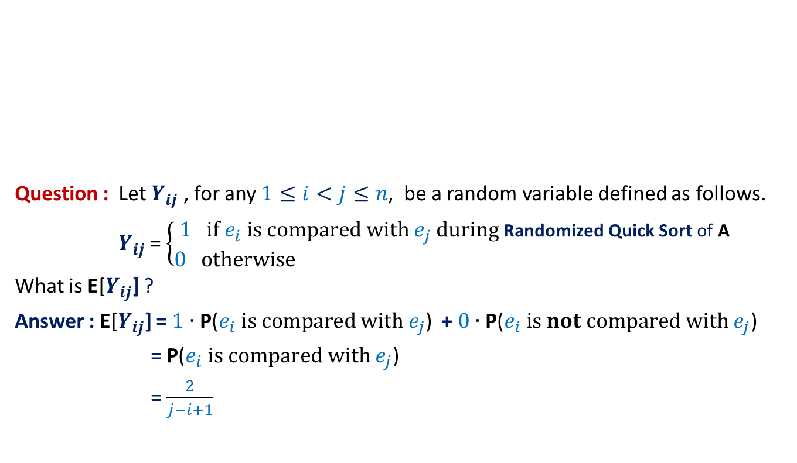
Randomized Quick Sort (number of comparisons)
Elements of A arranged in Increasing order of values
$$e_{i}$$
Question : Let $Y_{ij}$ , for any $1≤i<j≤n$, be a random variable defined as follows.
$Y_{ij}$ = $\left\{\begin{matrix}1 if e_{i} is compared with e_{j} during \text{Randomized} \text{Quick} \text{Sort} \text{of} \text{A} \\ 0 otherwise \end{matrix}\right.$
What is E[$Y_{ij}$] ?
Answer : E[$Y_{ij}$] = $1$ $∙$ $\text{P}\text{(}e_{i} is compared with e_{j}\text{)}$ + $0$ $∙$ $\text{P}\text{(}e_{i} is not compared with e_{j}\text{) }$
= $\text{P}\text{(}e_{i} is compared with e_{j}\text{)}$
= $\frac{2}{j−i+1}$

Slide 39
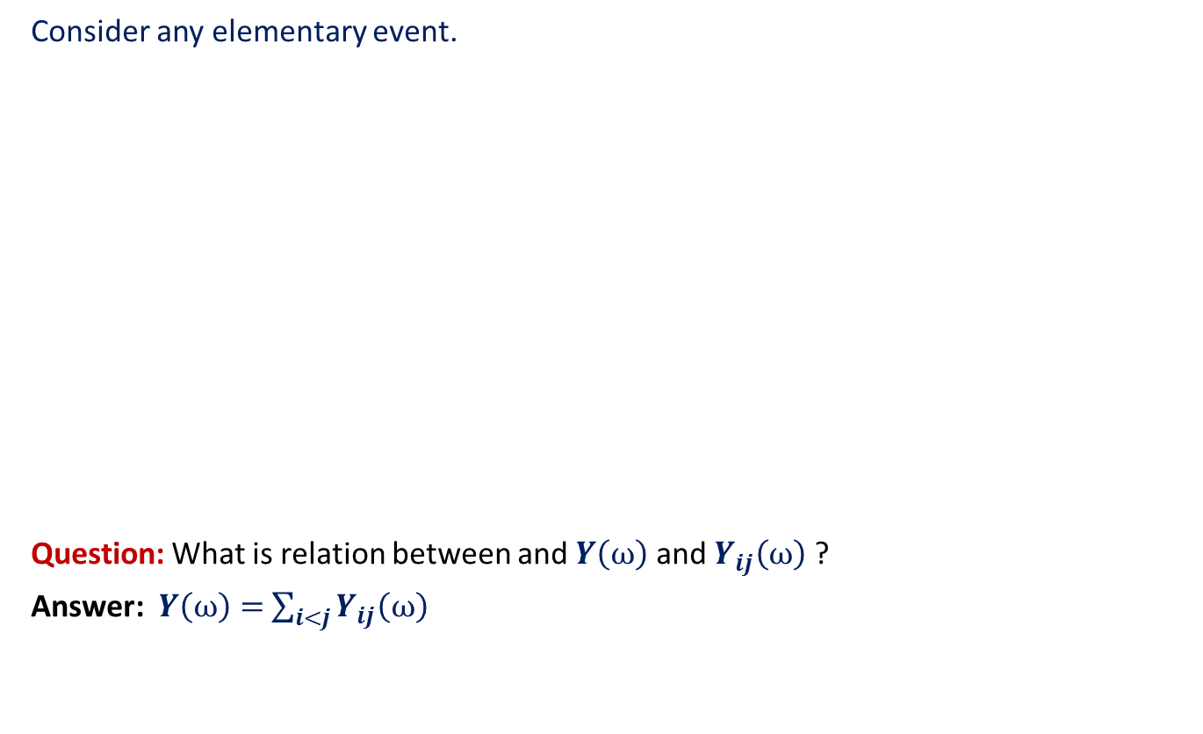



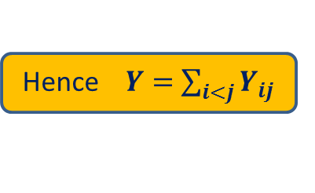
Randomized Quick Sort (any relation between $Y$ and $Y_{ij}$’s ?)
Consider any elementary event.
Question: What is relation between and $Y\left(ω\right)$ and $Y_{ij}\left(ω\right)$ ?
Answer: $Y\left(ω\right)=$ $\sum_{i<j}{Y_{ij}\left(ω\right)}$
Any elementary event
$$ω$$
$Y_{12}(ω){ Y}_{13}(ω)$ … $Y_{1n}(ω)$ $Y_{23}(ω)$ $Y_{24}(ω)$ … $Y_{n−1 n}(ω)$
1 0 … 0 1 1 … 0
for each $ω$ ϵ Ω
Hence $Y=$ $\sum_{i<j}{Y_{ij}}$
number of comparisons

Slide 40
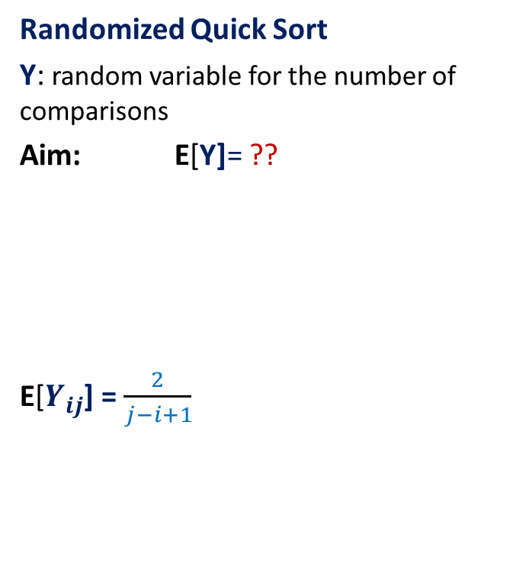

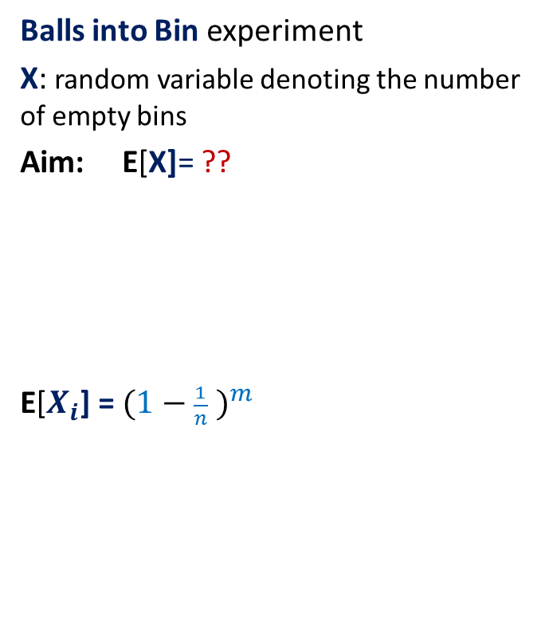
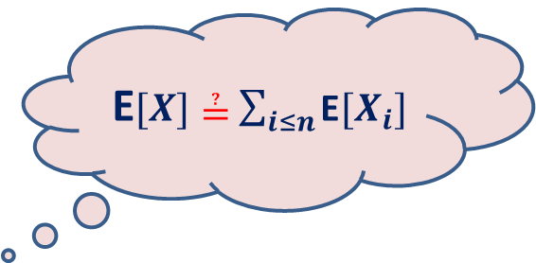
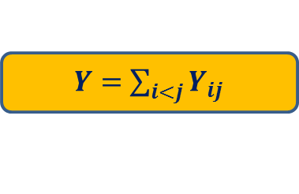
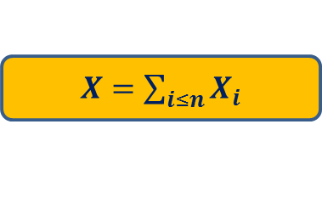
What have we learnt till now?
Balls into Bin experiment
X: random variable denoting the number of empty bins
Aim: E[X]= ??
E[$X_{i}$] = ${(1−\frac{1}{n} )}^{m}$
Randomized Quick Sort
Y: random variable for the number of comparisons
Aim: E[Y]= ??
E[$Y_{ij}$] = $\frac{2}{j−i+1}$
$X=$ $\sum_{i≤n}{X_{i}}$
$Y=$ $\sum_{i<j}{Y_{ij}}$
E$[X]≟$ $\sum_{i≤n}{\text{E}[X_{i}]}$
E$[Y]≟$ $\sum_{i<j}{\text{E}[Y_{ij}]}$

Slide 41
Spend few hours today trying to answer the questions of the previous slide.

